Slide 1
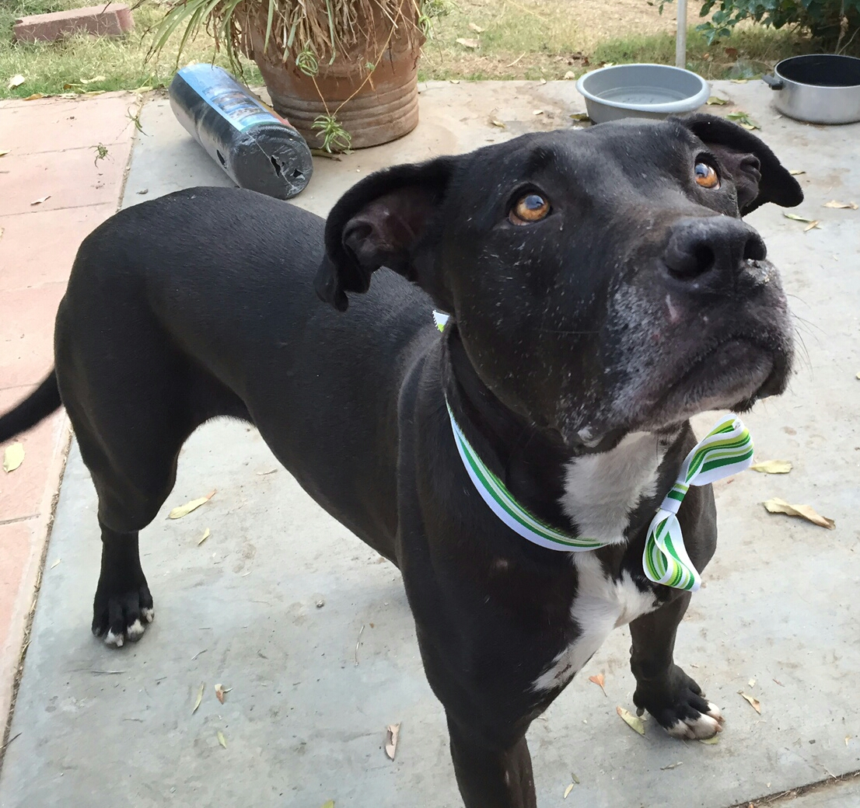
Looking for Love Mining Dog Adoption Vocabulary

Slide 2
Mine descriptive texts from a canine adoption website to find words that extend time on site.
Source: www.puppyfinder.com
Scrape website
Available features: name, gender, description, age category (Baby, Young, Adult, Senior), date posted, breed, locale

Slide 3
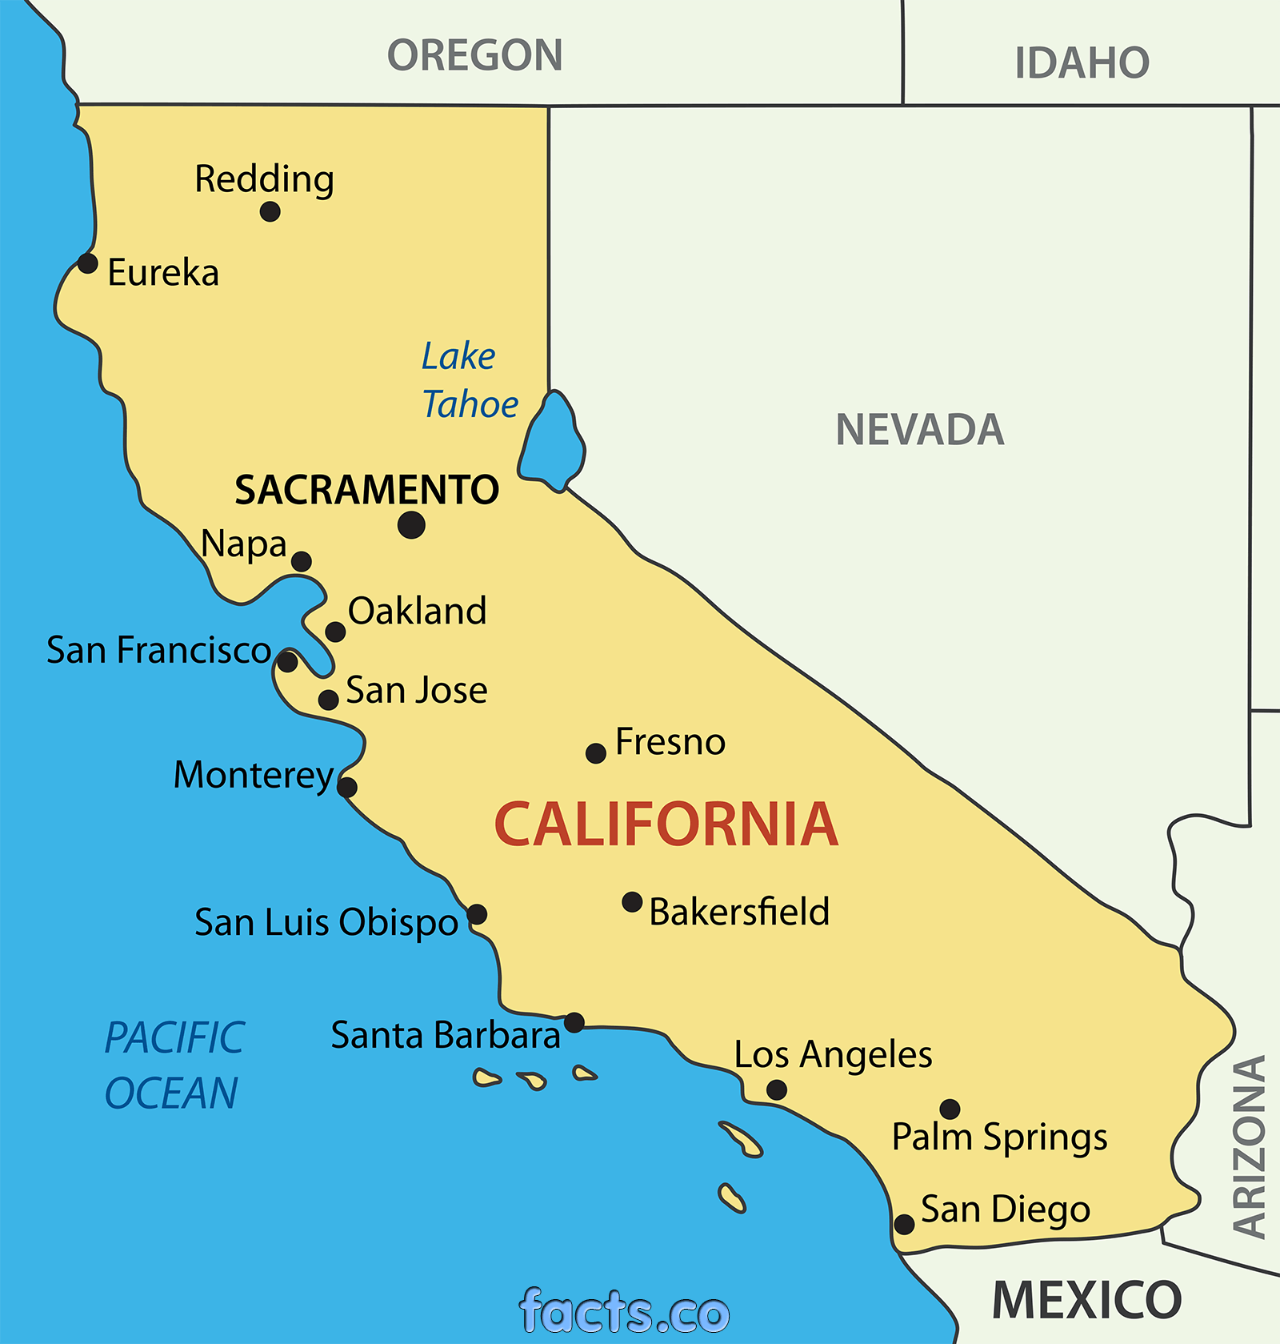
Sampling
Only dogs for adoption.
Only dogs from California (6500+).
Plan: Sample three times one week apart and look at changes in inventory.

Slide 4
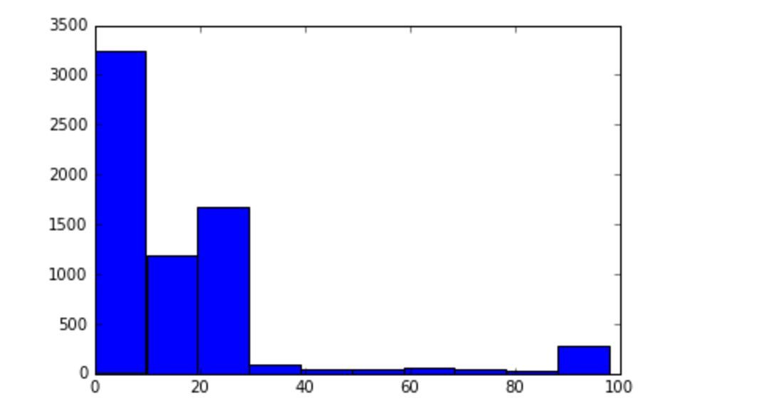
Data Problems
'2016-04-02', '2016-03-29', '2016-03-19', '2016-03-18',
'2016-03-08', '2016-03-07', '2016-03-06', '2016-03-05',
'2016-03-03', '2016-03-02', '2016-03-01', '2016-02-29',
'2016-02-28', '2016-02-27', '2016-02-25', '2016-02-24',
'2016-02-23', '2016-02-22', '2016-02-21', '2016-02-20',
'2016-02-19', '2016-02-18', '2016-02-17', '2016-02-16',...
2016-03-29 2035
2016-04-02 1199
2016-03-07 848
2016-03-18 682
2016-03-19 505
2016-03-06 460
2015-12-26 254
2016-03-05 200
2016-03-08 172
2016-02-29 25
2016-02-03 15
2016-02-24 15

Slide 5
Created Features
Sentiment (using TextBlob package)
Subjectivity (using TextBlob package)
Days on Site = max date – posted date
Age in years = extracted from description
Is_male (1 if yes, 0 if no)
Age categorical : Young, Adult, Senior
Time on site: 1 if less than 40 days, 0 if longer

Slide 6
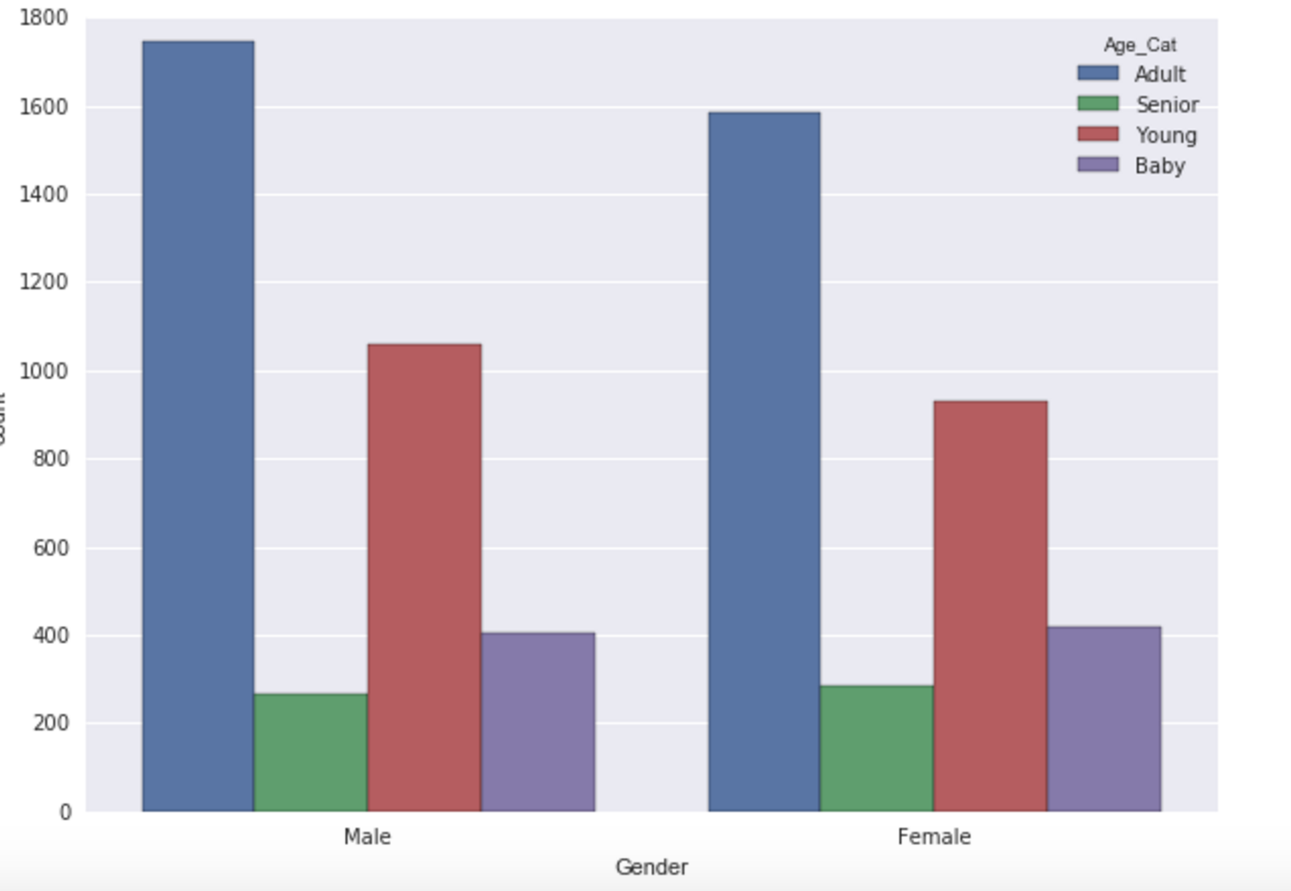
Gender by Age

Slide 7
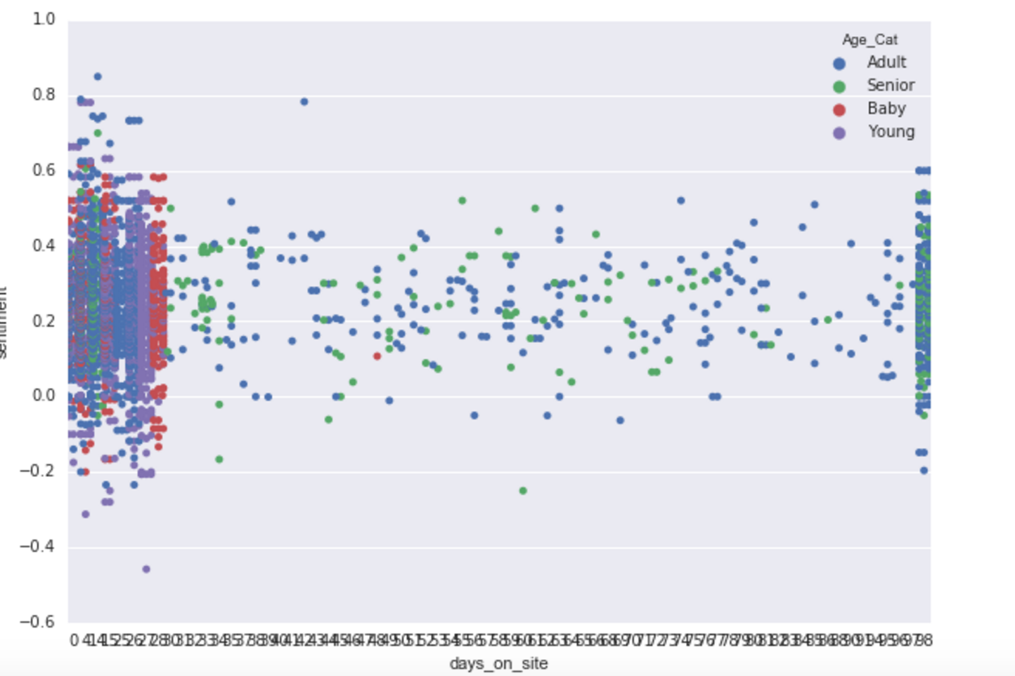
Sentiment by days on site

Slide 8
A different, simple vocabulary
Dog breed.
This is a very special vocabulary but it has meaning and emotional power.
Listing the dogs by breed gave me the idea to mine the breeds for value. Instead of using the breeds as class variables (there are a lot of breeds) I would employ vocabulary tools.

Slide 9
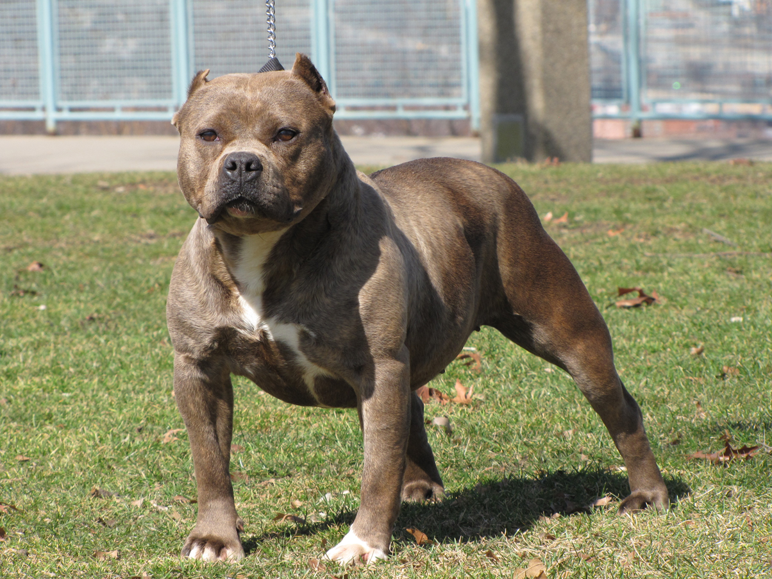
American Pit Bull #1

Slide 10

Chihuahua: The # 2 breed

Slide 11
Top 15 Breeds
Breed | Count
Mutt | 913
American Pit Bull Terrier | 555
Chihuahua-Unknown Mix | 452
Chihuahua | 405
American Pit Bull Terrier-Unknown Mix | 404
Labrador Retriever-Unknown Mix | 300
German Shepherd Dog | 200
German Shepherd Dog-Unknown Mix | 100
American Bulldog | 100
American Staffordshire Terrier-Unknown Mix | 96
Dachshund-Unknown Mix | 91
American Staffordshire Terrier | 89
Boxer | 80
Labrador Retriever | 80
Chiweenie | 76

Slide 12
Age Characteristics
 | Sentiment (mean/sd) | Days on Site (mean/sd)
Baby | .25/.12 | 11/10
Young | .24/.13 | 15/11
Adult | .24/.12 | 21./26
Senior | .24/.12 | 36/37

Slide 13
Lasso to Explore Data
X=['is_male' 'is_rescue’ 'sentiment' 'subjectivity’ 'agecat_Adult' 'agecat_Senior' 'agecat_Young’ 'american’ 'australian' 'boxer' 'bull' 'bulldog' 'chihuahua' 'dachshund' 'dog’ 'german' 'labrador' 'miniature' 'mix' 'mutt' 'pit' 'poodle’ 'retriever' 'shepherd' 'staffordshire' 'terrier' 'unknown']
Y=days_on_site
Dog breed words were extracted using CountVectorizer over the Breed feature with max_features set to 20.

Slide 14
A WYSIWYG Result
agecat_Young = -0.15283189
agecat_Adult = 0.52657824
agecat_Senior = 4.70832842
All other features converged to zero. The intercept is 18.52 .
From this we see that a Senior dog is predicted to be on the site 4.7 days longer than a Baby, but a Young dog will be on the site less time than a Baby.
Notes:
Adult = 3,4,6,15 Baby=2,2,5,10 Senior=4,8,10,16 Young=2,3,4,13

Slide 15
Estimated Ages for Age Categories
Baby: median age of 2, max=10
Young: median age of 2, max=13
Adult: median age of 4, max=15
Senior: median age of 8, max=16
Age as extracted from the Description field.

Slide 16
Logistic Analysis with Sense
Created a variable called sense which is 1 for a dog with sentiment greater than the mean of all sentiments (.241) , 0 otherwise. A good dog has a sense of 1.
The mean of sense is .48 so 48% of dogs are good dogs.

Slide 17
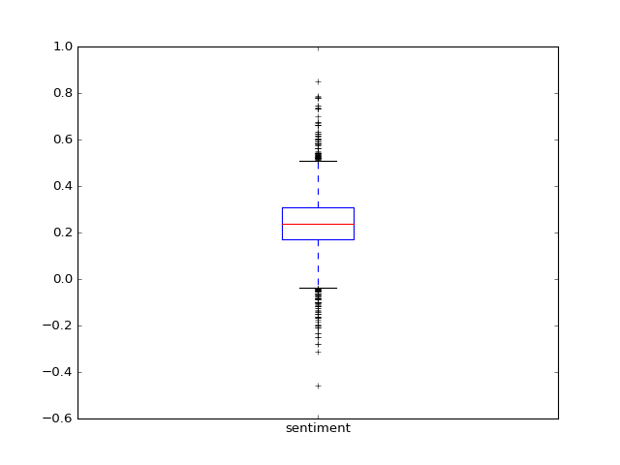
Sentiment with Outliers

Slide 18
Simple modeling where y=sense and the features are our 20 breed vocabulary words
Logistic regression:
score=0. 54324724806
Random Forest Classifier 3000 trees: score=0.560718887197
Bernoulli Naive Bayes:
score=0. 546330810922
These results are better than the mean = .48

Slide 19
Logistic Regression Coefficients
word | coef | effect | word | coef | effect
american | 0.151 | 16% | miniature | 0.040 | 4%
australian | 0.210 | 23% | mix | 0.001 | 0%
boxer | 0.254 | 29% | mutt | 0.322 | 38%
bull | -0.275 | -24% | pit | 0.467 | 60%
bulldog | 0.135 | 14% | poodle | 0.074 | 8%
chihuahua | -0.405 | -33% | retriever | -0.004 | 0%
dachshund | 0.324 | 38% | shepherd | -0.061 | -6%
dog | -0.627 | -47% | staffordshire | 0.467 | 60%
german | 0.499 | 65% | terrier | 0.124 | 13%
labrador | 0.315 | 37% | unknown | 0.122 | 13%

Slide 20
The Confusion Matrix
 | Predicted “Bad” | Predicted “Good”
Observed “Bad” | 1634 | 1091
Observed “Good” | 1153 | 1335

Slide 21
Predictions
“american” “pit” “bull” “terrier”
Predicted Result = 1 (good) with the probability of a “bad”= 46% and a “good”= 54%
“chihuahua” Predicted Result = 0 (bad) with the probability of a “bad”= 66% and a “good”= 33%

Slide 22

Thank you and have a nice day

Slide 23
Karla Leibowitz
Sf-DAT 20, April 6, 2016

Slide 24
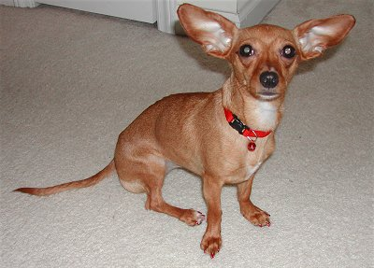
This is a Chiweenie.

